Slide 1
Beyond the green button! 2010
Thomas Sampson

Slide 2

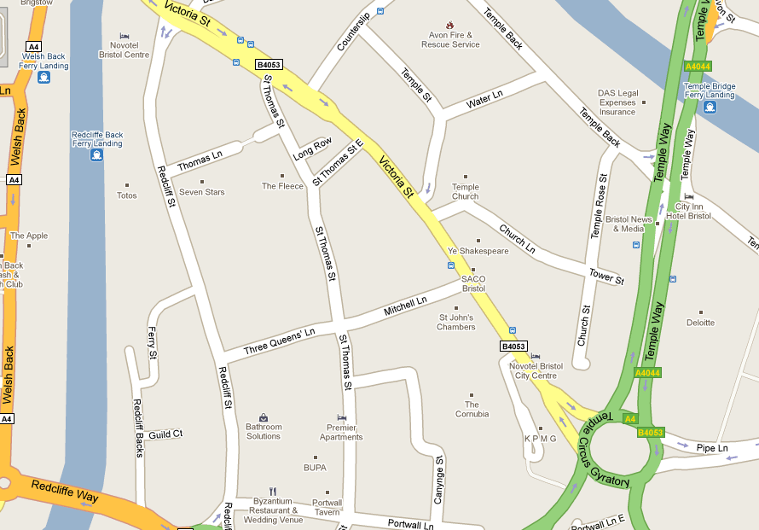


Introduction
About me
Studying Games Software Development at Sheffield Hallam University.
Began placement at SN Systems Summer 2009.
Returning in September 2010.

Slide 3
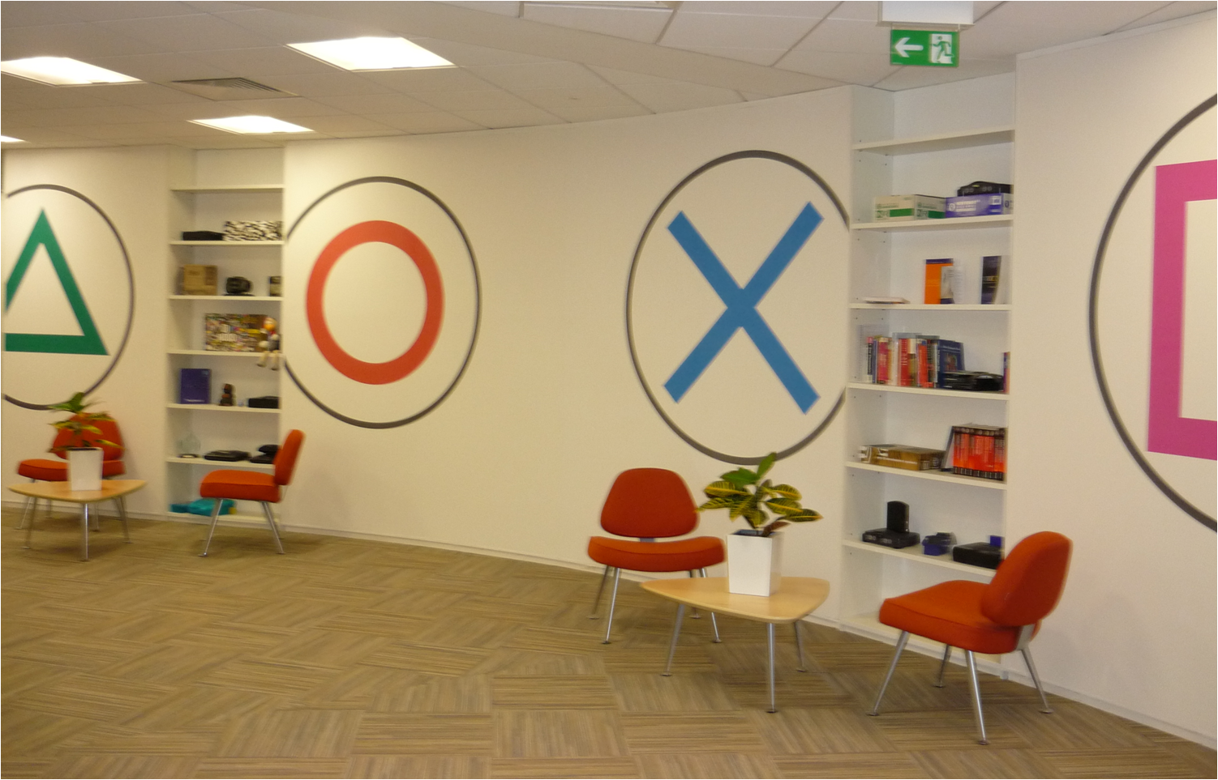

Introduction
SN Systems
SN Systems Ltd, started in 1988.
Produce tools for the games industry used by developers across a number of platforms.
Purchased by Sony Computer Entertainment in 2005.

Slide 4
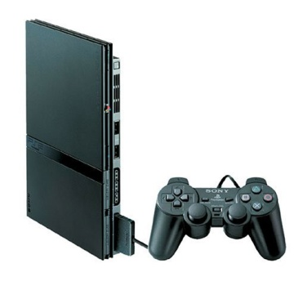

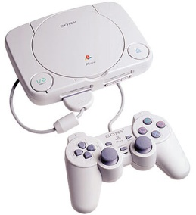





Introduction
SN Systems
Platforms
Products
Toolchain
Compiler
Assembler
Linker
Binutils
Target Manager
Debugger
Tuner
DBS

Slide 5
Introduction
Presentation Overview
Beyond the green button?
The chain of events which occur between hitting “Debug” and stepping into “main”.
Why should anyone care anyway?
Tools Developers.
Code optimization.
Build times.
Aids diagnosis of warnings and errors at all stages (compile / link / runtime).
Developers of new languages / compilers / interpreters.
Anyone really interested in hardware and computing?
Not EVERYONE uses Visual Studio !!
Notes:
Does anyone have any guesses on the meaning of the title? Although I won’t be talking about SN tools directly and will be talking about Microsoft tools (more applicable for uni), a lot of the content of this presentation is platform independent and applies to any platform you might be working on. (Will reference SN tools)
2) There isn’t a processing unit in existence which can execute lines of C++ (or any other human readable language)…..
3) This information is NOT mandatory, many comfortable with windows development + visual studio….
- Obviously SN systems have a strong interest etc…
- Better understanding of compiler internals can help us to write better more efficient code
- Compilation times – project structure, use of libraries, dependencies

Slide 6

Introduction
Presentation Structure
1. Order & Project structure
2. The Pre-processor
3. The Compiler
4. Symbols and debug data
5. The Linker
6. Useful tools
Notes:
1) Does anyone have any guesses on the meaning of the title? Provide explanation…
2) There isn’t a processing unit in existence which can execute lines of C++ (or any other human readable language)…..
3) This information is NOT mandatory, comfortable with windows development + visual studio….
- Obviously SN systems have a strong interest etc…
- Better understanding of compiler internals can help us to write better more efficient code
- Compilation times – project structure, use of libraries, dependencies

Slide 7

Order & Project Structure
Project Ordering
Sample Game Solution
ApplicationLog
RenderSystem
GameEngine
MainGame
ParticleSystem
Notes:
Before talking about the build process it’s self, Best place to start is a top down look at a sample project
A sample of a solution with project dependencies
WARNING: Circular dependencies

Slide 8
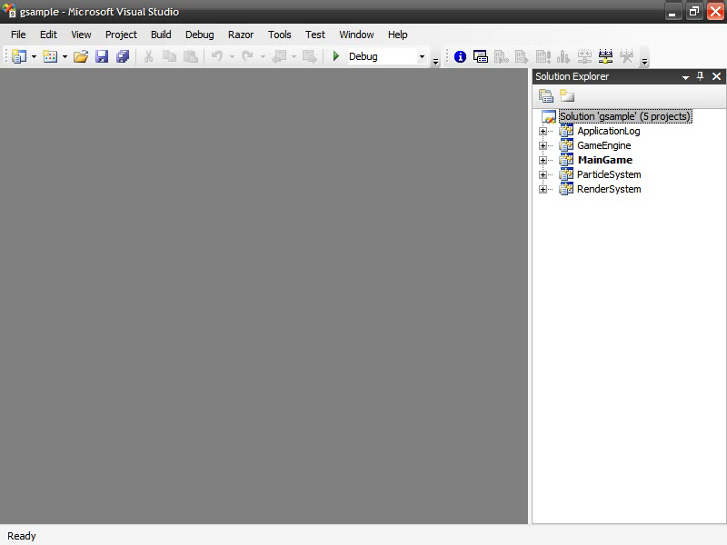

Order & Project Structure
Project Ordering
Sample Game Solution
ApplicationLog
RenderSystem
GameEngine
MainGame
ParticleSystem
Notes:
Before talking about the build process it’s self, Best place to start is a top down look at a sample project
A sample of a solution with project dependencies
WARNING: Circular dependencies

Slide 9
Order & Project Structure
Project Ordering
Sample Game Solution
1.
2.
ApplicationLog
RenderSystem
4.
GameEngine
5.
3.
MainGame
ParticleSystem
Notes:
Before talking about the build process it’s self, Best place to start is a top down look at a sample project
A sample of a solution with project dependencies
WARNING: Circular dependencies

Slide 10
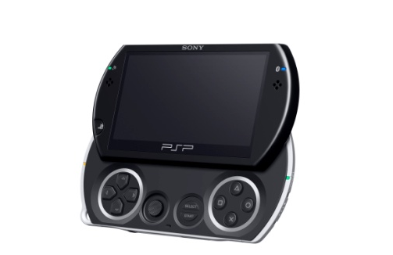
Order & Project Structure
File Ordering
Cpp files generally have no inter-dependencies.
Order does not really matter.
Each .c / .cpp file represents a compilation/translation unit.
Header files are only found via #include and never compiled directly.
Notes:
Talked about project ordering, now to file ordering.
Cpp files generally have no inter-dependencies. (will wait until link stage to find missing implementations).

Slide 11
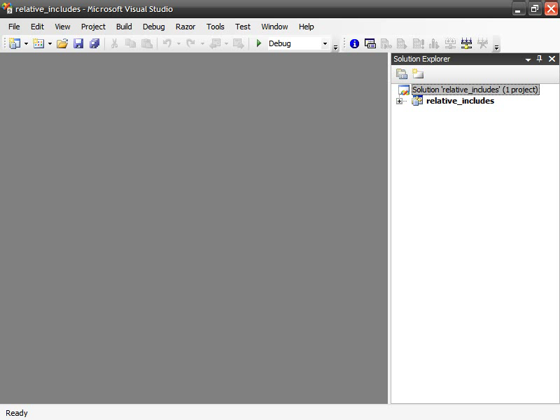
Order & Project Structure
File Inclusion
Some include files are in the project directory, e.g. #include “foo.h”.
Some include files are in locations relative to the project directory.
Notes:
Talked about project ordering, now to file ordering.
Cpp files generally have no inter-dependencies. (will wait until link stage to find missing implementations).

Slide 12
Order & Project Structure
File Inclusion
Some include files are in the project directory, e.g. #include “foo.h”.
Some include files are in locations relative to the project directory.
Some include files are in pre-defined system include directories, e.g #include <stdio.h>
Notes:
Talked about project ordering, now to file ordering.
Cpp files generally have no inter-dependencies. (will wait until link stage to find missing implementations).

Slide 13
Order & Project Structure
File Inclusion
Template instantiation error!
lmits.h
yvals.h
yvals.h
xiosbase.h
stdio.h
yvals.h
yvals.h
stdlib.h
climits.h
cstdio.h
cstdlib.h
streambuf.h
xlocnum.h
ios.h
otream.h
itream.h
MSbuild: /showIncludes
Gcc: -H
iostream.h
Main.cpp
Notes:
Green icons – Header guards…..Multiply defined symbols.
Red icon, compiler error referring to file you have never seen , use /showIncludes to help diagnose issue.

Slide 14
Order & Project Structure
File Ordering
5>Note: including file: c:\Program Files (x86)\Microsoft Visual Studio 9.0\VC\include\iostream
5>Note: including file: c:\Program Files (x86)\Microsoft Visual Studio 9.0\VC\include\istream
5>Note: including file: c:\Program Files (x86)\Microsoft Visual Studio 9.0\VC\include\ostream
5>Note: including file: c:\Program Files (x86)\Microsoft Visual Studio 9.0\VC\include\ios
5>Note: including file: c:\Program Files (x86)\Microsoft Visual Studio 9.0\VC\include\xlocnum
5>Note: including file: c:\Program Files (x86)\Microsoft Visual Studio 9.0\VC\include\climits
5>Note: including file: c:\Program Files (x86)\Microsoft Visual Studio 9.0\VC\include\yvals.h
5>Note: including file: c:\Program Files (x86)\Microsoft Visual Studio 9.0\VC\include\crtdefs.h
5>Note: including file: c:\Program Files (x86)\Microsoft Visual Studio 9.0\VC\include\sal.h
5>Note: including file: c:\program files (x86)\microsoft visual studio 9.0\vc\include\codeanalysis\sourceannotations.h
5>Note: including file: c:\Program Files (x86)\Microsoft Visual Studio 9.0\VC\include\crtassem.h
5>Note: including file: c:\Program Files (x86)\Microsoft Visual Studio 9.0\VC\include\vadefs.h
5>Note: including file: c:\Program Files (x86)\Microsoft Visual Studio 9.0\VC\include\use_ansi.h
5>Note: including file: c:\Program Files (x86)\Microsoft Visual Studio 9.0\VC\include\limits.h
5>Note: including file: c:\Program Files (x86)\Microsoft Visual Studio 9.0\VC\include\crtdefs.h
5>Note: including file: c:\Program Files (x86)\Microsoft Visual Studio 9.0\VC\include\cstdio
5>Note: including file: c:\Program Files (x86)\Microsoft Visual Studio 9.0\VC\include\stdio.h
5>Note: including file: c:\Program Files (x86)\Microsoft Visual Studio 9.0\VC\include\crtdefs.h
5>Note: including file: c:\Program Files (x86)\Microsoft Visual Studio 9.0\VC\include\swprintf.inl
5>Note: including file: c:\Program Files (x86)\Microsoft Visual Studio 9.0\VC\include\cstdlib
5>Note: including file: c:\Program Files (x86)\Microsoft Visual Studio 9.0\VC\include\stdlib.h
5>Note: including file: c:\Program Files (x86)\Microsoft Visual Studio 9.0\VC\include\crtdefs.h
5>Note: including file: c:\Program Files (x86)\Microsoft Visual Studio 9.0\VC\include\streambuf
5>Note: including file: c:\Program Files (x86)\Microsoft Visual Studio 9.0\VC\include\xiosbase
5>Note: including file: c:\Program Files (x86)\Microsoft Visual Studio 9.0\VC\include\xlocale
5>Note: including file: c:\Program Files (x86)\Microsoft Visual Studio 9.0\VC\include\cstring
5>Note: including file: c:\Program Files (x86)\Microsoft Visual Studio 9.0\VC\include\string.h
5>Note: including file: c:\Program Files (x86)\Microsoft Visual Studio 9.0\VC\include\crtdefs.h
5>Note: including file: c:\Program Files (x86)\Microsoft Visual Studio 9.0\VC\include\stdexcept
5>Note: including file: c:\Program Files (x86)\Microsoft Visual Studio 9.0\VC\include\exception
5>Note: including file: c:\Program Files (x86)\Microsoft Visual Studio 9.0\VC\include\xstddef
5>Note: including file: c:\Program Files (x86)\Microsoft Visual Studio 9.0\VC\include\cstddef
5>Note: including file: c:\Program Files (x86)\Microsoft Visual Studio 9.0\VC\include\stddef.h
5>Note: including file: c:\Program Files (x86)\Microsoft Visual Studio 9.0\VC\include\crtdefs.h
5>Note: including file: c:\Program Files (x86)\Microsoft Visual Studio 9.0\VC\include\eh.h
5>Note: including file: c:\Program Files (x86)\Microsoft Visual Studio 9.0\VC\include\crtdefs.h
5>Note: including file: c:\Program Files (x86)\Microsoft Visual Studio 9.0\VC\include\malloc.h
5>Note: including file: c:\Program Files (x86)\Microsoft Visual Studio 9.0\VC\include\crtdefs.h
5>Note: including file: c:\Program Files (x86)\Microsoft Visual Studio 9.0\VC\include\xstring

Slide 15

Order & Project Structure
Good Project Structure
Most important for large code bases.
Can massively improve build times, difference between 10 hours and 10 minutes.
Minimum number of dependencies.
Forward declarations where possible.
Split large projects into separate libraries.
Benefits other areas such as re-factoring and unit testing.
Notes:
From past experience that’s how it can feel when looking over a large code base for the first time.
Most important for large code bases (but still good practice).
Refer to build times.
Reduction from 10 hours to 10 minutes.
Minimum number of dependencies. (mention piece of string analogy).
Forward declarations where possible.
Self contained modules best for unit testing. Fewer dependencies, easier it is to unit test a piece of code.

Slide 16
Order & Project Structure
Pre-compiled Headers
Exist to improve build times.
Should be used judiciously, modifying a pre-compiled header forces a full rebuild.
Different ways of determining which headers should be pre-compiled.
Most compilers support some flavour of pre-compiled headers.
Notes:
Used well < build time, used badly > build time.
Mention rating system (number of #includes and number of times included + 1).
How to use? Visual studio right from wizard, file should include stdafx.h
Warning: Not portable, if headers include any implementation, breaks pch system.

Slide 17
Order & Project Structure
Build Job Overview
2.
3.
4.
5.
MainGame
1.
ApplicationLog
RenderSystem
ParticleSystem
GameEngine
1.1
cpp
2.1
cpp
3.1
cpp
4.1
cpp
5.1
cpp
1.2
cpp
2.2
cpp
3.2
cpp
4.2
cpp
5.2
cpp
1.3
cpp
2.3
cpp
3.3
cpp
4.3
cpp
5.3
cpp
1.4
cpp
2.4
cpp
3.4
cpp
4.4
cpp
5.4
cpp

Slide 18
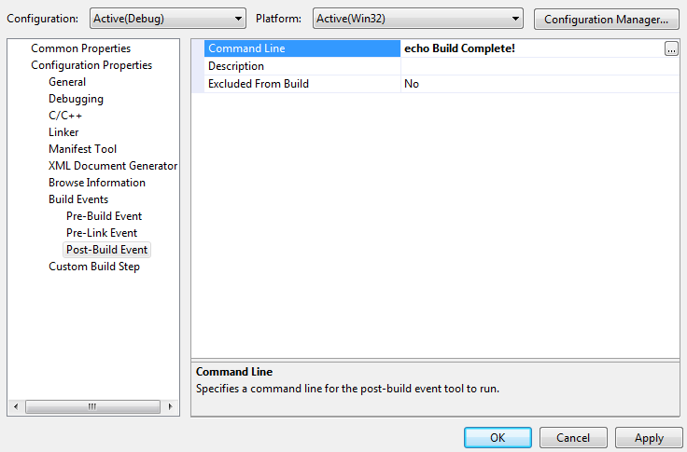
Order & Project Structure
C / C++
Order of Events
Pre-build
Compiler
Pre-processor
Linker
Pre-link
Assembler
Post-build
Library / Executable
Notes:
Why use the build events?
Example: Copying files to output directory, processing/signing the executable/ invoking an installer build
Example: To add in timing etc

Slide 19
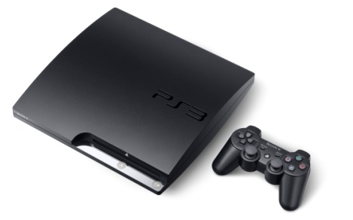
Pre-Processor
Overview
Works through source code files (.c / .cpp) programmatically.
Expands #include
Expands #define
Expands macros
Handles #if, #ifdef, #undef, etc
Allows build process to be aborted when #error is reached
Provides line information to the build system (with #line)
Notes:
Pre-processor is the FIRST stage of the build process.
global vars Vs #define ?
- if, ifdef, undef = Pre-processor directives , flags inside the pre-processor to determine which parts of the source code are used and which are excluded (example if #debug). Cross platform development

Slide 20

Pre-Processor
Demo
Pre-Processor
Demo
Notes:
Show toggling 2 sections of code being compiled with global pp def.

Slide 21
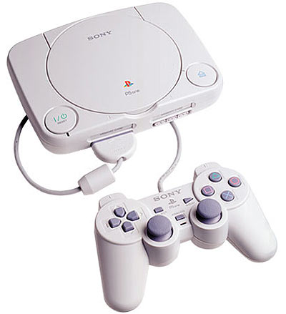
Pre-Processor
Overview
1.
PreProcessorExample
Main.cpp
Car.h

Slide 22
Pre-Processor
Example
Main.cpp
#include "Car.h"
int main(int argc, char* argv[])
{
char* timestamp = __DATE__;
printf("Last compiled: %s \n",timestamp);
Car a;
a.DisplayInfo();
return 0;
}

Slide 23
Pre-Processor
Example
Car.h
Car.h (After pre-processing)
#ifndef MY_CLASS_H_
#define MY_CLASS_H_
#include <iostream>
#include <string.h>
#include <cmath>
#define MAX_SPEED 120.5f
#define ROUNDMPH(num) ceil(num)
class Car
{
private:
float m_speed;
public:
explicit Car() : m_speed(MAX_SPEED) {}
void DisplayInfo()
{
//Display message stating maximum speed
char buffer[100];
sprintf_s(buffer, strlen(buffer),
"My maximum speed is %.2f", ROUNDMPH(m_speed));
printf(buffer);
}
};
#endif
//Contents of iostream
//Contents of string.h
//Contents of cmath
class Car
{
private:
float m_speed;
public:
explicit MyClass() : m_speed(120.5f) {}
void DisplayInfo()
{
char buffer[100];
sprintf_s(buffer, strlen(buffer),
"My maximum speed is %.2f", ceil(m_speed));
printf(buffer);
}
};

Slide 24
Pre-Processor
Example
Main.cpp
Main.cpp (After pre-processing)
int main(int argc, char* argv[])
{
char* timestamp = __DATE__;
printf("Last compiled: %s \n",timestamp);
Car a;
a.DisplayInfo();
return 0;
}
class Car
{
private:
float m_speed;
public:
explicit MyClass() : m_speed(120.5f) {}
void DisplayInfo()
{
char buffer[100];
sprintf_s(buffer, strlen(buffer),
"My maximum speed is %.2f", ceil(m_speed));
printf(buffer);
}
};
int main(int argc, char* argv[])
{
char* timestamp = "Feb 10 2010";
printf("Last compiled: %s \n",timestamp);
Car a;
a.DisplayInfo();
return 0;
}

Slide 25
Pre-Processor
Summary
Doesn’t analyze the code.
Doesn’t compile any code.
Doesn’t inline function (decision made by compiler).
Happens before any syntax checks are carried out.

Slide 26
Compiler
Overview
What does the compiler do?
Traditionally works on one translation unit at a time.
Transforms human readable code into machine executable operations.
Bridges the semantic gap between man and machine.
Applies optimizations to the code we write.
Organizes parts of our program into sections.
Creates a re-locatable object file per execution unit (which can be linked to form libraries, DLLs and executables).

Slide 27
Compiler
Overview
How do compilers achieve this?
Lexical analysis on source code.
Syntax checking.
Construction of symbol table.
Intermediate representations of program in memory such as AST (Abstract Syntax Tree) and CFG (Control Flow Graph).
Analysis of program flow, data usage, operations and branching conditions to form optimizations (–Ox).
Different ways of optimizing based on the desired result (e.g. fastest code Vs smallest code).
Splits program into sections used by the linker to combine modules.
Notes:
Lexical: Parse character by character matching tokens and verifying structure.
Syntax checking:, type matching etc
Symbol table: (variable names, method names, class names, namespaces etc)
Optimizations: Loop unrolling, constant folding, instruction re-ordering, if/else re-ordering for pipeline etc.
Sections: Not just code, mention resource compiling, games industry often pushed to fit game onto optical media.

Slide 28

Compiler
1.
2.
Compile Process
RenderSystem
ApplicationLog
COMPILER
COMPILER
1.1
cpp
2.1
cpp
COMPILER
COMPILER
1.2
cpp
2.2
cpp
COMPILER
COMPILER
1.3
cpp
2.3
cpp
1.4
cpp
2.4
cpp
2.2.obj
2.3.obj
2.4.obj
1.4.obj
2.1.obj
1.1.obj
1.2.obj
1.3.obj

Slide 29



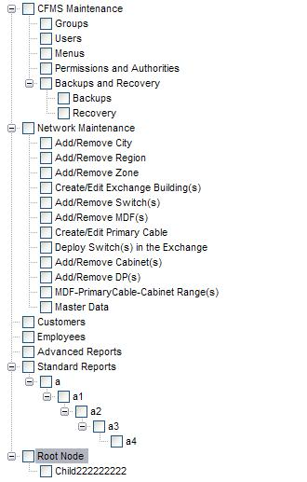
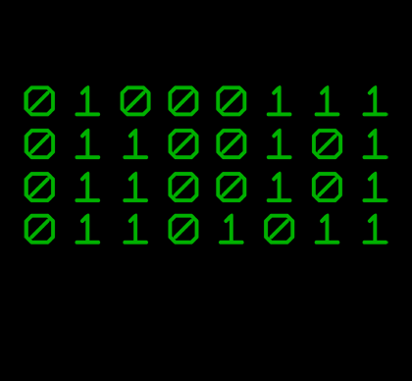
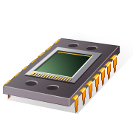

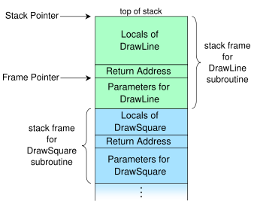
Compiler
Compiler Internals
Compiler Driver
Compiler Front End
Construction of AST and other internal structures
Lexical Analysis & Syntax checking
Construction of symbol table
Construction of IL representation
Optimization of IL
Compiler Back End
Target specific implementation of ABI
(call stack / calling conventions etc)
Transformation from IL to target instructions
Register allocation and target specific optimizations made.
Organization of program into sections
Creation of executable / library.
Notes:
Compiler front end – can be bought of the shelf (hardware agnostic)
Lexical analysis, broken into tokens, full syntax checking
Symbol table entries for variables, structures, functions, namespaces, typedefs etc
Talk a little about IL representations, language agnostic representation of the program. Pseudo register allocation etc.
Compiler back end – often interchangeable per platform
Translates IL into target hardware instructions
Translates register allocations.
Hardware specific optimizations. Uses specific hardware instructions (for maths etc).
Implementation of calling convention. ABI
Organization of code into sections.
Executable / Library creation.

Slide 30
Compiler
Abstract Syntax Tree
AST Demo
Notes:
Demo of TR4 Viewer (relate to AST)

Slide 31
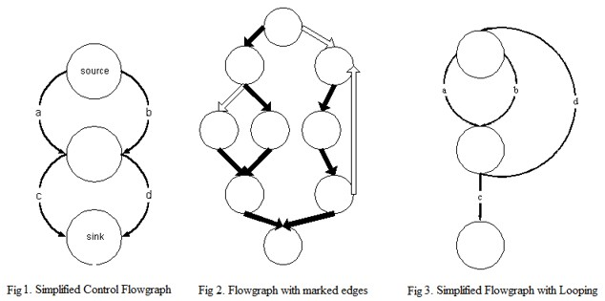
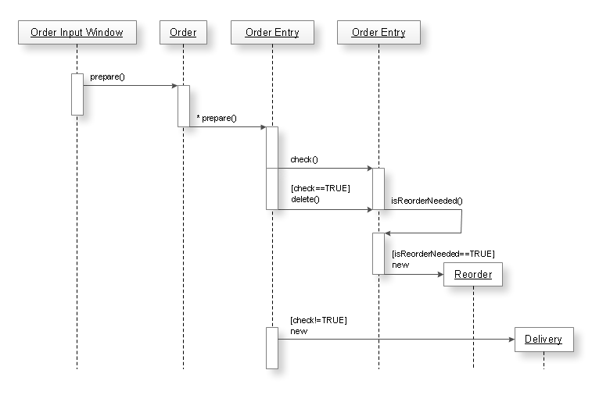
Compiler
Control Flow Graph (CFG)
Analogous to sequence diagrams.
The basis on which many optimizations are discovered / applied.
Identifies all possible routes through a function.
Identifies problems such as infinite loops and unreachable code.
Notes:
Things to mention
The basis on which many optimizations are applied.
Each node on diagram represents a basic block (give definition).
Reveals infinite loops
Reveals unreachable code
Allows for static analysis
One of benefits of interpreted languages is dynamic analysis.

Slide 32
Compiler
Symbol Table
A data structure used internally inside the compiler.
Used to map symbols to additional information.
What are “symbols” ?
Function declarations.
Variable declarations.
Type declarations (classes/structs/unions/enums).
Type definitions.
What additional information can be mapped to symbols?
Type information
Scope information
Address and line number information.

Slide 33
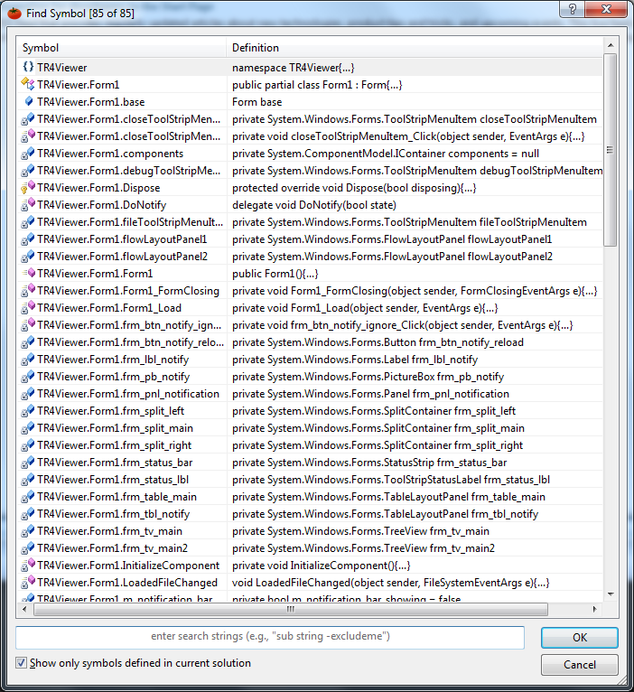
Compiler
Symbol Table Uses
How can the symbol table be used?
During the development process can be used to quickly navigate between symbols across multiple source files.
At compile time symbol table is placed inside the resulting object file in order to resolve dependencies at link time.
If the symbol table is not stripped by the linker it can be exploited by a debugger to replace variable and function addresses with their respective symbol names.
Notes:
Mention intellisense uses static parse analysis not actually the symbol table used by the compiler.

Slide 34
Compiler
Abstract Syntax Tree
Debugger Symbol Table Usage
Notes:
Demo toggling symbol names in assembly view in visual studio using debugger_symbol_demo.sln
Show loaded .pdb file

Slide 35
Compiler
Code Sections
All contents of object files are organized into sections.
Sections are used to keep different kinds of data separate.
Each section has different properties providing information such as whether the data in the section is loadable and whether the data in the section should be read only / read write.
Common sections from each object file involved in the compile process are combined and merged by the linker.
Object File
Section name Loadable? Executable? R/W?
.debug No No Read Only
.text Yes Yes Read Only*
.data Yes No Read/Write
.rodata Yes No Read Only
.bss No No Read/Write
.ctors Yes Yes Read Only
.dtors Yes Yes Read Only
Notes:
.debug – contains symbol table + additional debug data
.text – contains all of the code, usually read only (some tricks in limited memory environments can write code to code memory!)
. data – All initialized global /static variables and other global data
. rodata – All read-only data (const variables and arrays, resources etc).
.bss – A section to hold all uninitialized data
.ctors – This section holds an array of the global constructor function pointers of a program.
.dtors – This section holds an array of the global destructor function pointers of a program.
Brings us nicely onto the linker...............

Slide 36
Linker
Overview
What does the linker do?
Takes a list of object files as input.
Carries out dead stripping.
Resolves link time dependencies (using symbol table).
Removes debug information (optional).
Programmatically combines common sections from all object files.
Determines entry point (executable only).
Produces library / DLL / executable.

Slide 37


Linker
Output
Executable
Static Library
Dynamically
Linked Library (DLL)
Is loadable by the target operating system.
Provides information to the OS program loader via the program header table.
Contains an entry point.
May request DLL usage at runtime (can fail if DLL not present).
Can be attached to by a debugger.
Is a self contained library that can be linked by the linker and embedded in an executable.
Usually produced for sharing code and distributed with a header file.
Named “static” as function entry points are baked into the parent executable at compile time.
Is a self contained library that can be resident on the OS or distributed with the executable.
Is loaded by the executable at runtime. Executable will fail if not present.
Loaded only once by the OS, multiple executables can share the same DLL at runtime.

Slide 38
Linker
Output
Executable
Static
Library
DLL Stub Library
Static
Library
DLL Stub Library
Static
Library
Static
Library
DLL Stub Library
Target Environment
Static
Library
Static
Library
Static
Library
DLL
DLL
DLL
Notes:
Mention security vulnerabilities.

Slide 39
Linker
Overview
How does the linker achieve this?
The list of object files (produced by the compiler) are given to the linker as part of the build system (often the compiler driver or makefile).
Sections are checked and combined using information from section header table in each object file.
Object File
Section Header Table
.rodata – 0x00000000 .data – 0x00000F00
.text – 0x00EC000 .ctors – 0x0A00F00
0x00000000
.rodata
0x00000F00
.data
0x000EC000
.text
0x0A000F00
.ctors

Slide 40
Linker
Overview
Output File
Object File
Section Header Table
.rodata – 0x00000000 .data – 0x00000F00
.text – 0x00EC000 .ctors – 0x0A00F00
Linker
0x00000000
.rodata
.rodata
0x00000F00
.data
.rodata
0x000EC000
.text
.rodata
0x0A000F00
.ctors
.data
Object File
.data
Section Header Table
.rodata – 0x00000000 .data – 0x00000F00
.text – 0x00EC000 .ctors – 0x0A00F00
Linker
.data
0x00000000
.rodata
0x00000F00
.data
0x000EC000
.text
.text
0x0A000F00
.ctors
.text
.text
Object File
Section Header Table
.rodata – 0x00000000 .data – 0x00000F00
.text – 0x00EC000 .ctors – 0x0A00F00
Linker
.ctors
0x00000000
.rodata
.ctors
0x00000F00
.data
.ctors
0x000EC000
.text
0x0A000F00
.ctors

Slide 41



Linker
Operating System
Program Loader
Output File
Main Memory
Program Header Table
Process Address Space
.bss
Space for initializing global data
.bss
.rodata
.rodata
.rodata
.rodata
.data
.data
.data
.data
EIP
.data
.data
.data
.text
.text
.text
.text
.text
.text
.ctors
.ctors
EBP
Stack
.ctors
.ctors
.ctors
.ctors
ESP
.debug
.debug
.debug

